Slide 1
PROFITABILITY ANALYSIS OF ADIDAS IN THE US MARKET
By,
Mr Balaji Janardhan

Slide 2

1

Slide 3
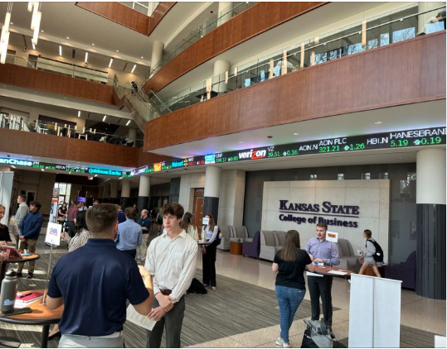
2

Slide 4
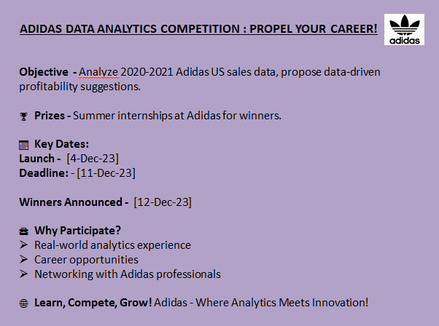


Slide 5


Slide 6
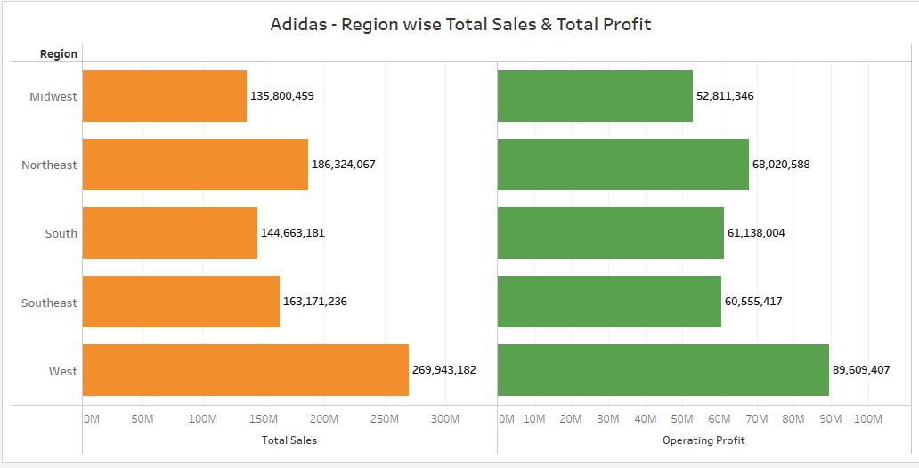
EXPLORATORY DATA ANALYSIS - DISCOVERING INSIGHTS

Slide 7
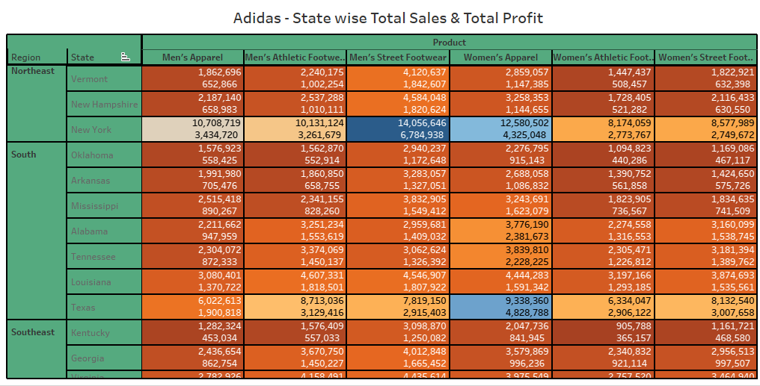
EXPLORATORY DATA ANALYSIS - DISCOVERING INSIGHTS

Slide 8
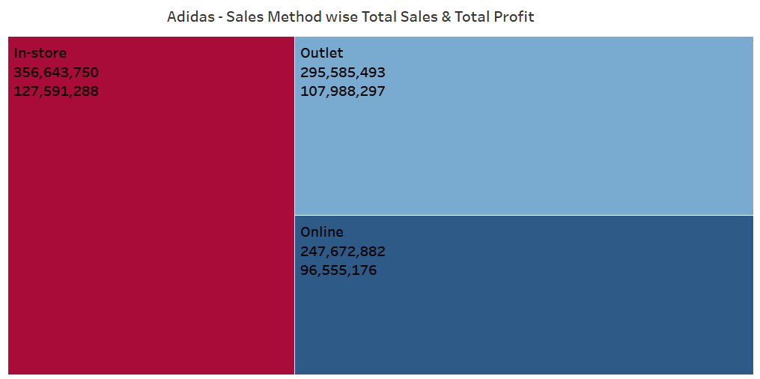
EXPLORATORY DATA ANALYSIS - DISCOVERING INSIGHTS

Slide 9
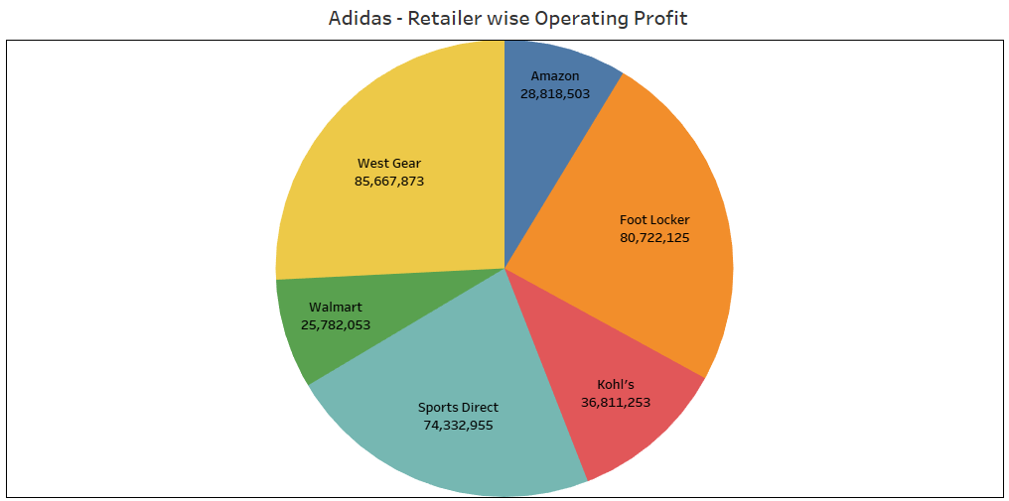
EXPLORATORY DATA ANALYSIS - DISCOVERING INSIGHTS

Slide 10
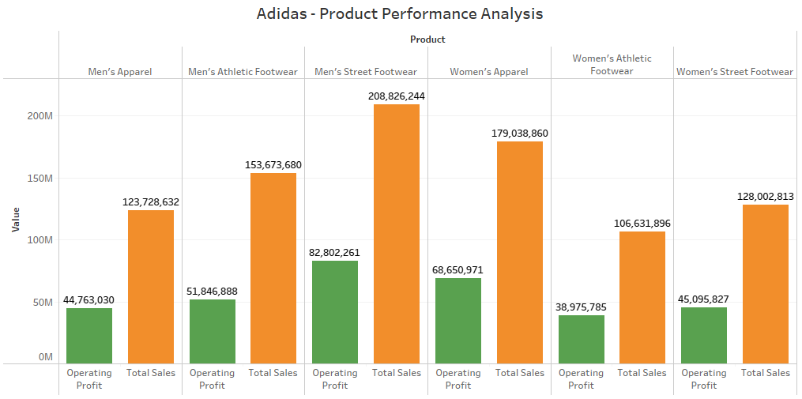
EXPLORATORY DATA ANALYSIS - DISCOVERING INSIGHTS

Slide 11
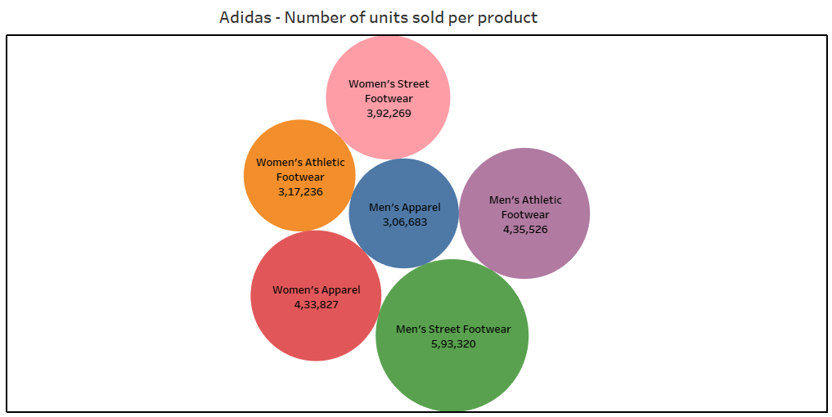
EXPLORATORY DATA ANALYSIS - DISCOVERING INSIGHTS

Slide 12
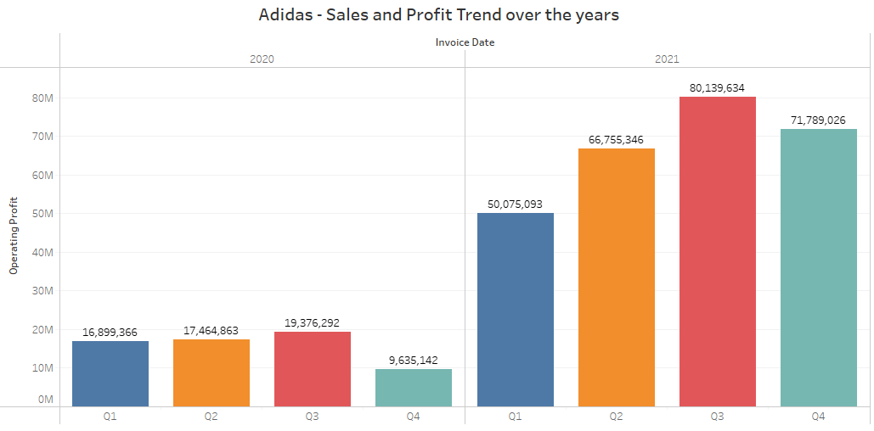
EXPLORATORY DATA ANALYSIS - DISCOVERING INSIGHTS

Slide 13
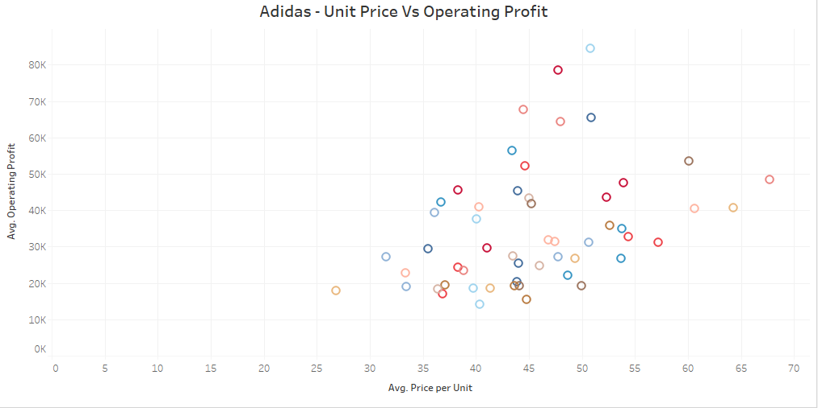
EXPLORATORY DATA ANALYSIS - DISCOVERING INSIGHTS

Slide 14
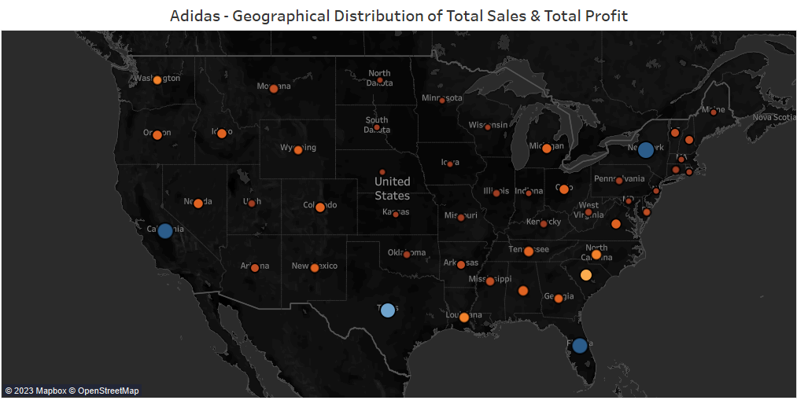
EXPLORATORY DATA ANALYSIS - DISCOVERING INSIGHTS

Slide 15
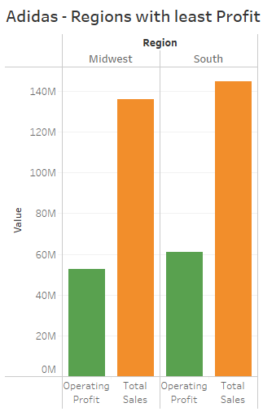
EXPLORATORY DATA ANALYSIS - DISCOVERING INSIGHTS
Market Research –
Conduct detailed market research in the identified regions to understand local consumer preferences, behaviours, and trends.
Explore competitors' strategies and performance in these regions to identify potential gaps and opportunities
Promotional Campaigns –
Design targeted marketing and promotional campaigns to raise awareness and drive sales in the identified regions.
Leverage local events, traditions, or holidays to create impactful and culturally relevant campaigns

Slide 16
EXPLORATORY DATA ANALYSIS - DISCOVERING INSIGHTS
Partnerships and Collaborations –
Forge partnerships with local retailers, influencers, or sports organizations to enhance brand visibility.
Collaborate with local businesses or influencers for joint marketing initiatives
Localized Marketing –
Customize marketing materials, including advertisements and social media content, to resonate with the local audience.
Use local languages, imagery, and cultural references to connect with consumers on a personal level.

Slide 17
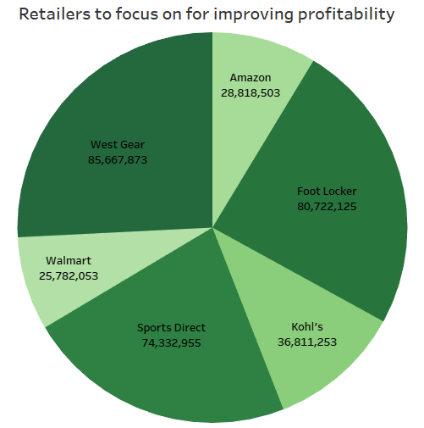
EXPLORATORY DATA ANALYSIS - DISCOVERING INSIGHTS
Amazon -
Optimize product listings for discoverability
Leverage Amazon advertising for visibility
Participate in Amazon programs like Prime
Ensure competitive pricing strategies
Walmart -
Enhance storefront on Walmart.com
Invest in Walmart advertising for visibility
Offer exclusive discounts and special deals
Collaborate with Walmart's merchandising teams
Align strategies with Walmart's promotional calendar.
Kohl’s -
Optimize in-store product placement and displays
Participate in Kohl's promotional events

Slide 18
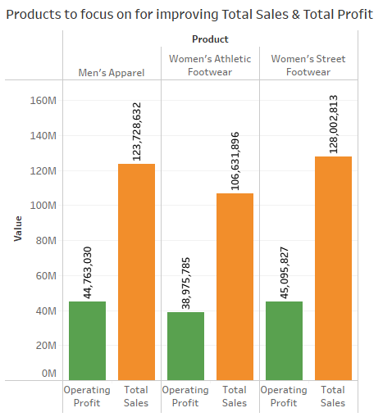
EXPLORATORY DATA ANALYSIS - DISCOVERING INSIGHTS
Product Innovation -
Introduce trendsetting designs and features.
Targeted Marketing -
Develop campaigns highlighting unique product attributes.
Pricing Strategies -
Evaluate and adjust pricing for competitiveness.
Implement limited-time discounts.
In-Store Optimization -
Optimize product placement for visibility.
Customer Engagement -
Gather feedback for continuous product improvement.
Strategic Collaborations -
Partner with influencers or athletes for endorsements.

Slide 19
MODEL BUILDING
Optimizing operational efficiency
Supply chain management
Streamlining internal processes
Negotiating better deals with suppliers
Adopting cost-effective production methods
Market trends analysis
Industry advancements knowledge
Social media use for marketing

Slide 20


Slide 21

20

Slide 22
THANK YOU!

